Slide 1
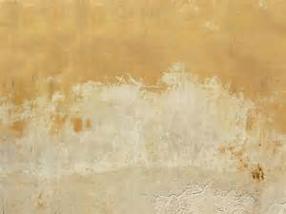

Praise the Name of the Lord
November

Slide 2
Praise the Name of the Lord
Let us praise the name of the Lord
for His name alone is exalted.
His splendor is above the earth and the heavens.
Genesis 1:31

Slide 3
Praise the Name of the Lord

Slide 4
Praise the Name of the Lord
Chord Name Pitches Color
F chord F A C Blue
Bb chord Bb D F Green
Gm chord G Bb D Yellow
C chord C E G Red

Slide 5
Praise the Name of the Lord

Slide 6
Praise the Name of the Lord

Slide 7
Praise the Name of the Lord
PERCUSSION PART

Slide 8
Praise the Name of the Lord
CITATIONS
Native American backgrounds, retrieved October 25, 2015 from wallpaper-kid.com

