Slide 1

In God’s Hand
March

Slide 2
In God’s Hand
In God’s hand is the life of every creature
and the breath of all humankind.
Job 12:10

Slide 3
In God’s Hand
Job 12:10

Slide 4
In God’s Hand
Job 12:10
BASS PART

Slide 5
In God’s Hand
G— G— DD D—
G— G— DD D—
G— G— DD D—
D— D— GG G—

Slide 6
In God’s Hand
ALTO PART

Slide 7
In God’s Hand

Slide 8
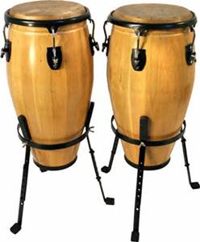
In God’s Hand
CONGA PART

Slide 9
In God’s Hand
CITATIONS
By Psych USD - Own work, CC BY-SA 3.0, https://commons.wikimedia.org/w/index.php?curid=19933888
By Peter Trimming - http://www.flickr.com/photos/peter-trimming/6583159839/, CC BY 2.0, https://commons.wikimedia.org/w/index.php?curid=29980115
By Yathin S Krishnappa - Own work, CC BY-SA 3.0, https://commons.wikimedia.org/w/index.php?curid=23241619
By Elma from Reykjavík - Gullfiskur, CC BY 2.0, https://commons.wikimedia.org/w/index.php?curid=8566914
<a href="http://www.freepik.com/free-photos-vectors/background">Background vector created by Kjpargeter - Freepik.com</a>

