Slide 1

The World Is Mine
April

Slide 2
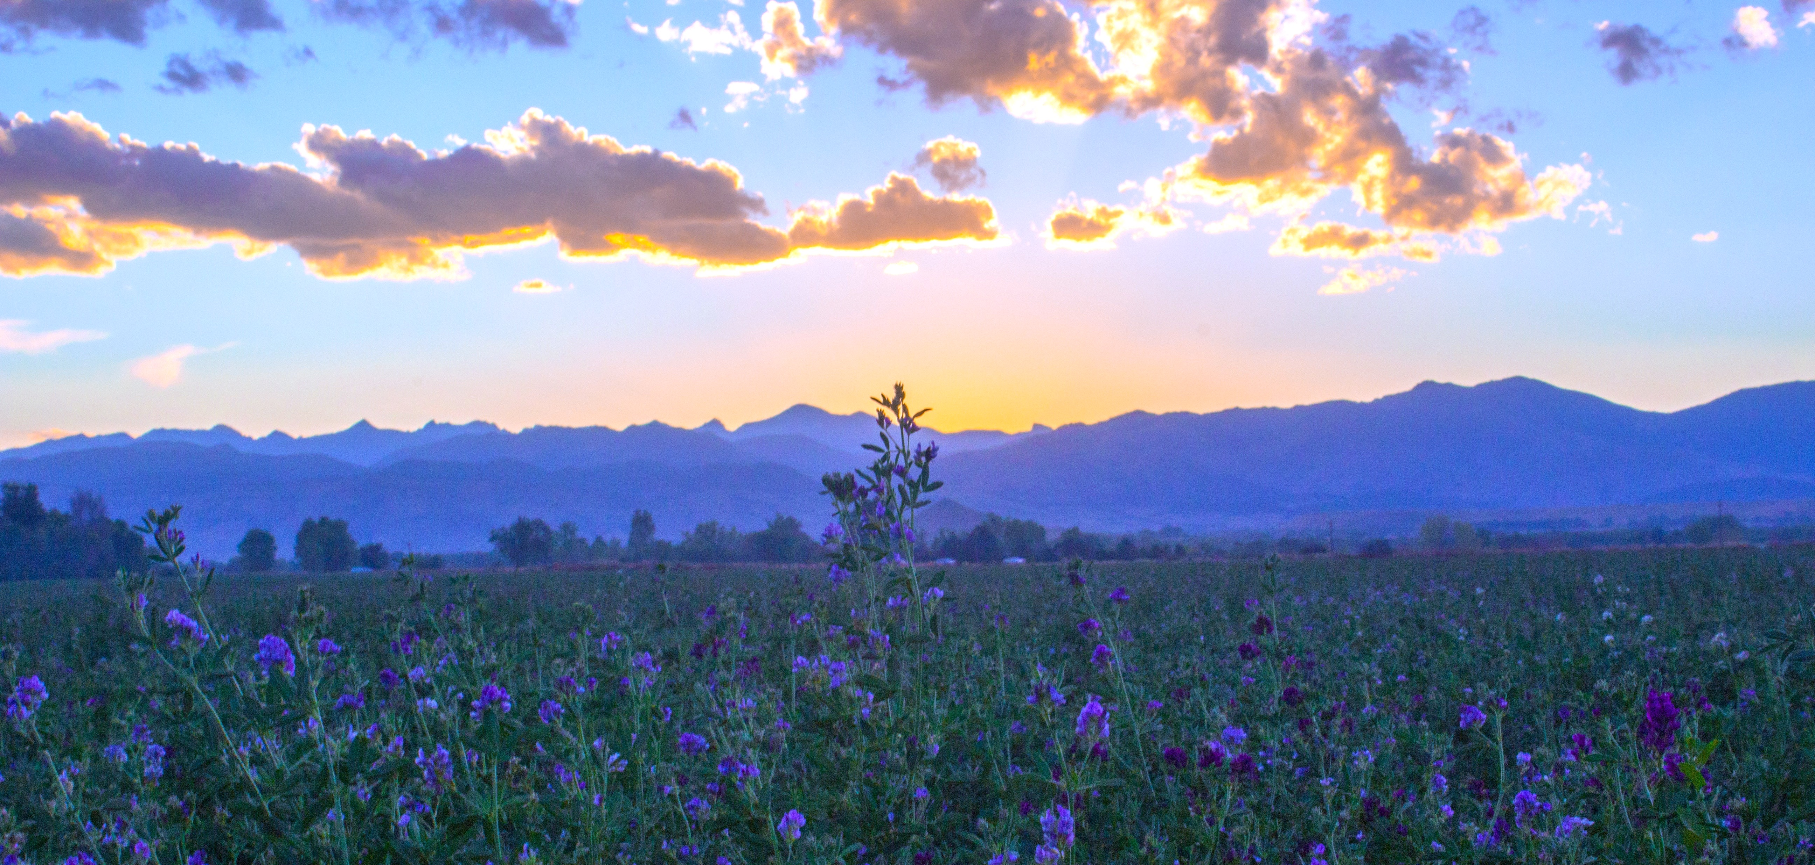
The World Is Mine
The world is mine
and all that is in it.
Psalm 50:12

Slide 3
The World Is Mine

Slide 4
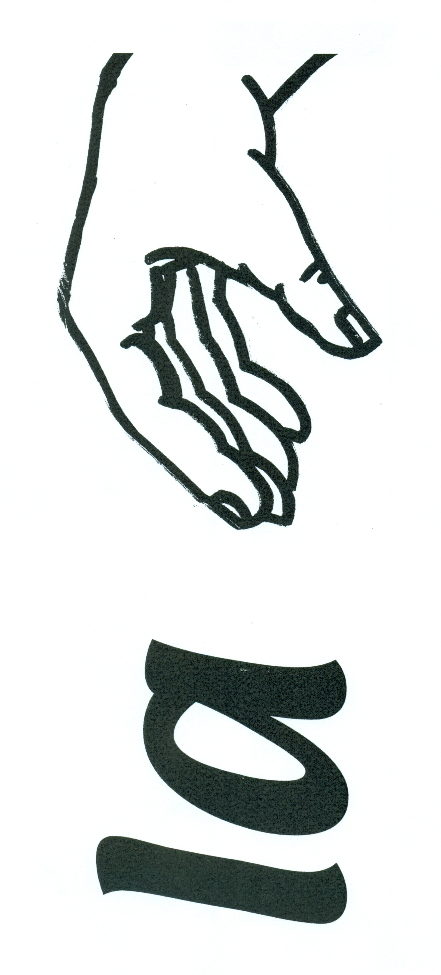

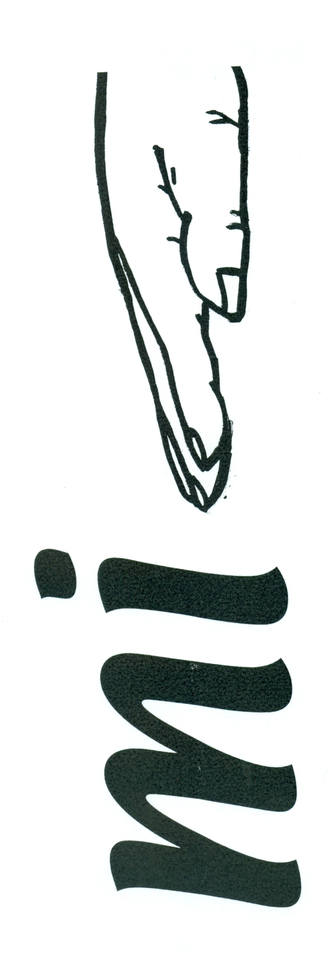
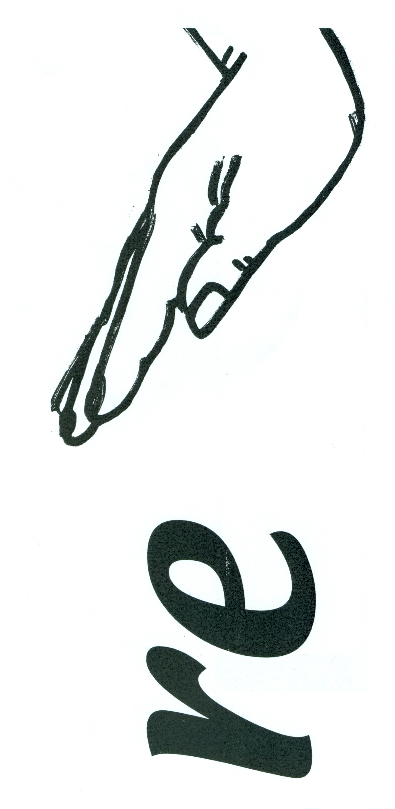
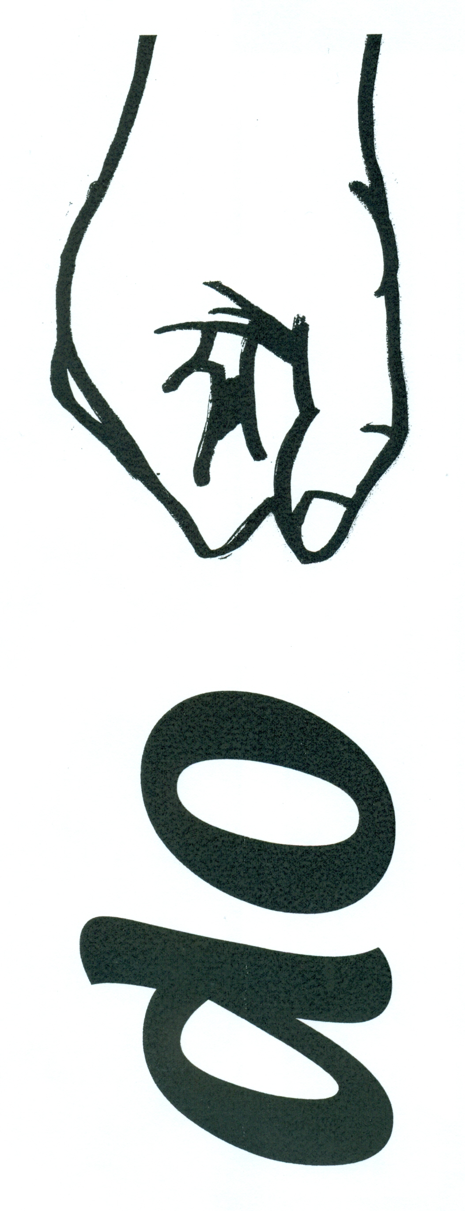
The World Is Mine

Slide 5
The World Is Mine
The animals of the forest
The cattle on a thousand hills
Every bird in the mountains
And the insects in the fields.

Slide 6
The World Is Mine
Each line of text should begin with do, mi, or sol. The end of each line should end on mi or sol.
The last note should be the home tone; in this case, do.
La is an unimportant note, usually heard before sol (as the word “the” is heard before a noun).
Use the same melody for lines one and three.
Melodies generally move stepwise with a few skips or leaps.

Slide 7
The World Is Mine
PERFORM:
A: sing the song with instrument parts
B: woods improvise, with drone
A: song with instrument parts
C: metals improvise, with drone
A: song with instrument parts

Slide 8
The World Is Mine
BASS PART

Slide 9
The World Is Mine
ALTO PART

Slide 10
The World Is Mine
GLOCKENSPIEL
PART

Slide 11
The World Is Mine
CONTRA BASS PART

Slide 12
The World Is Mine
CITATIONS
<a style="background-color:black;color:white;text-decoration:none;padding:4px 6px;font-family:-apple-system, BlinkMacSystemFont, &quot;San Francisco&quot;, &quot;Helvetica Neue&quot;, Helvetica, Ubuntu, Roboto, Noto, &quot;Segoe UI&quot;, Arial, sans-serif;font-size:12px;font-weight:bold;line-height:1.2;display:inline-block;border-radius:3px;" href="http://unsplash.com/@rmorton3?utm_medium=referral&amp;utm_campaign=photographer-credit&amp;utm_content=creditBadge" target="_blank" rel="noopener noreferrer" title="Download free do whatever you want high-resolution photos from Rob Morton"><span style="display:inline-block;padding:2px 3px;"><svg xmlns="http://www.w3.org/2000/svg" style="height:12px;width:auto;position:relative;vertical-align:middle;top:-1px;fill:white;" viewBox="0 0 32 32"><title></title><path d="M20.8 18.1c0 2.7-2.2 4.8-4.8 4.8s-4.8-2.1-4.8-4.8c0-2.7 2.2-4.8 4.8-4.8 2.7.1 4.8 2.2 4.8 4.8zm11.2-7.4v14.9c0 2.3-1.9 4.3-4.3 4.3h-23.4c-2.4 0-4.3-1.9-4.3-4.3v-15c0-2.3 1.9-4.3 4.3-4.3h3.7l.8-2.3c.4-1.1 1.7-2 2.9-2h8.6c1.2 0 2.5.9 2.9 2l.8 2.4h3.7c2.4 0 4.3 1.9 4.3 4.3zm-8.6 7.5c0-4.1-3.3-7.5-7.5-7.5-4.1 0-7.5 3.4-7.5 7.5s3.3 7.5 7.5 7.5c4.2-.1 7.5-3.4 7.5-7.5z"></path></svg></span><span style="display:inline-block;padding:2px 3px;">Rob Morton</span></a>

